Slide 1
Chapter 1
Overview of Electronic Commerce

Slide 2
Learning Objectives
Define electronic commerce (EC) and describe its various categories.
Describe and discuss the content and framework of EC.
Describe the major types of EC transactions.
Discuss e-commerce 2.0.
Understand the elements of the digital world.

Slide 3
Learning Objectives
Describe the drivers of EC as they relate to business pressures and organizational responses.
Describe some EC business models.
Describe the benefits and limitations of EC to organizations, consumers, and society.

Slide 4
Electronic Commerce: Definitions and Concepts
electronic commerce (EC)
The process of buying, selling, or exchanging products, services, or information via computer
e-business
A broader definition of EC that includes not just the buying and selling of goods and services, but also servicing customers, collaborating with business partners, and conducting electronic transactions within an organization

Slide 5
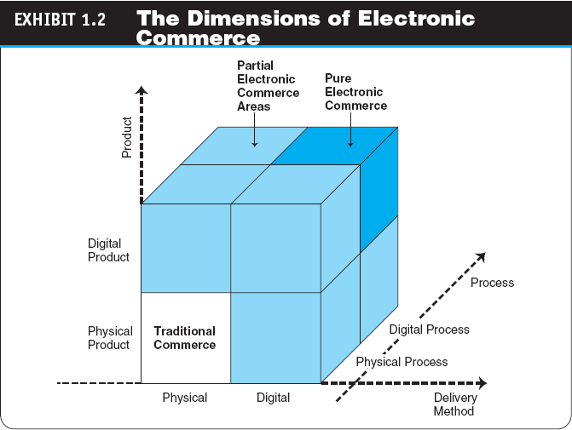
Electronic Commerce: Definitions and Concepts

Slide 6
Electronic Commerce: Definitions and Concepts
OTHER EC CONCEPTS
Pure Versus Partial EC
EC Organizations
brick-and-mortar (old economy) organizations
Old-economy organizations (corporations) that perform their primary business off-line, selling physical products by means of physical agents
virtual (pure-play) organizations
Organizations that conduct their business activities solely online
click-and-mortar (click-and-brick) organizations
Organizations that conduct some e-commerce activities, usually as an additional marketing channel

Slide 7
Electronic Commerce: Definitions and Concepts
electronic market (e-marketplace)
An online marketplace where buyers and sellers meet to exchange goods, services, money, or information
Sample: Alibaba.com, Amazon.com, eBay.com

Slide 8
Electronic Commerce: Definitions and Concepts
Interorganizational information systems (IOSs)
Communications systems that allow routine transaction processing and information flow between two or more organizations
Intraorganizational information systems
Communication systems that enable e-commerce activities to go on within individual organizations

Slide 9
The Electronic Commerce Field: Classification, Content, and History
intranet
An internal corporate or government network that uses Internet tools, such as Web browsers, and Internet protocols
extranet
A network that uses the Internet to link multiple intranets

Slide 10
The Electronic Commerce Field: Classification, Content, and History
AN EC FRAMEWORK
Five support areas for EC applications
People
Public policy
Marketing and advertisement
Support services
Business partnerships

Slide 11
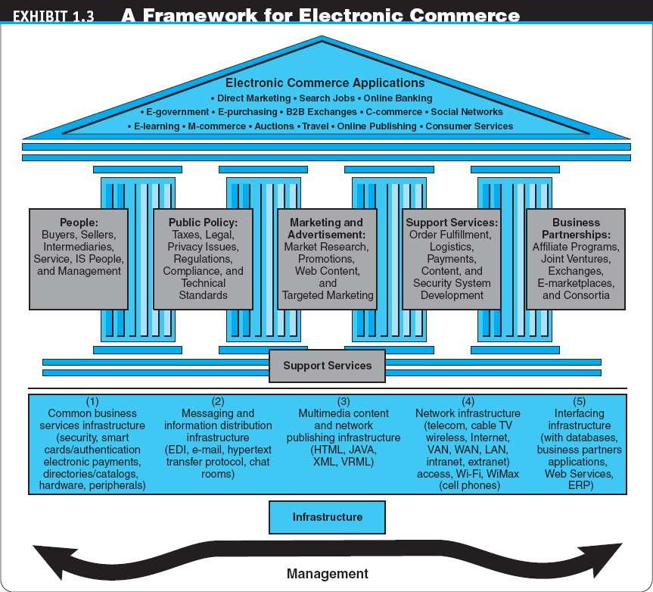

Slide 12
The Electronic Commerce Field: Classification, Content, and History
EC IS CLASSIFIED BY THE NATURE AND DIRECTION OF TRANSACTIONS AND INTERACTIONS
business-to-business (B2B)
E-commerce model in which all of the participants are businesses or other organizations
business-to-consumer (B2C)
E-commerce model in which businesses sell to individual shoppers
e-tailing
Online retailing, usually B2C

Slide 13
The Electronic Commerce Field: Classification, Content, and History
business-to-business-to-consumer (B2B2C)
E-commerce model in which a business provides some product or service to a client business that maintains its own customers
consumer-to-business (C2B)
E-commerce model in which individuals use the Internet to sell products or services to organizations or individuals who seek sellers to bid on products or services they need (e.g. www.priceline.com)

Slide 14
The Electronic Commerce Field: Classification, Content, and History
intrabusiness EC
E-commerce category that includes all internal organizational activities that involve the exchange of goods, services, or information among various units and individuals in an organization
business-to-employees (B2E)
E-commerce model in which an organization delivers services, information, or products to its individual employees

Slide 15
The Electronic Commerce Field: Classification, Content, and History
consumer-to-consumer(C2C)
E-commerce model in which consumers sell directly to other consumers (eg. eBay)
collaborative commerce (c-commerce)
E-commerce model in which individuals or groups communicate or collaborate online (eg. Boeing)

Slide 16
The Electronic Commerce Field: Classification, Content, and History
e-learning
The online delivery of information for purposes of training or education
e-government
E-commerce model in which a government entity buys or provides goods, services, or information from or to businesses or individual citizens

Slide 17
The Electronic Commerce Field: Classification, Content, and History
O2O (Online to Offline)
* combining the online shopping and the front line transactions
* usually provides information, services, booking discount and push the messages to Internet users, who in return will be converted into the customers of the particular offline business partners

Slide 18
The Electronic Commerce Field: Classification, Content, and History
O2O (Online to Offline) – cont.
* suitable to consumer goods and services, such as food and beverage, fitness, movies and beauty salon
* Online payment apply
* Group Purchasing is the pioneer of O2O
e.g. Groupon.com

Slide 19
E-Commerce 2.0: From Web 2.0 to Enterprise Social Networking and Virtual Worlds
social computing
An approach aimed at making the human-computer interface more natural
Web 2.0
The second-generation of Internet-based services that let people collaborate and share information online in new ways, such as social networking sites, wikis, communication tools, and folksonomies (collaborative tagging)

Slide 20
E-Commerce 2.0: From Web 2.0 to Enterprise Social Networking and Virtual Worlds
social network
A category of Internet applications that help connect friends, business partners, or individuals with specific interests by providing free services such as photo presentations,
e-mail, blogging, and so on using a variety of tools

Slide 21
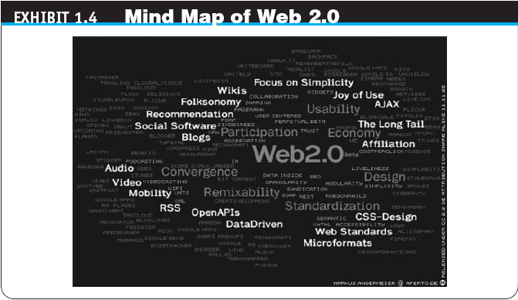
E-Commerce 2.0: From Web 2.0 to Enterprise Social Networking and Virtual Worlds

Slide 22
E-Commerce 2.0: From Web 2.0 to Enterprise Social Networking and Virtual Worlds
social network service (SNS)
A service that builds online communities by providing an online space for people to build free homepages and that provides basic communication and support tools for conducting different activities in the social network (eg. Facebook, youtube)
social networking
The creation or sponsoring of a social network service and any activity, such as blogging, done in a social network (external or internal)

Slide 23
E-Commerce 2.0: From Web 2.0 to Enterprise Social Networking and Virtual Worlds
enterprise-oriented networks
Social networks whose primary objective is to facilitate business
Examples of Enterprise Social Networks
carnivalconnections.com (eg. Cruise)
xing.com (eg. job agency)
Linkedin.com (eg. job agency)

Slide 24
E-Commerce 2.0: From Web 2.0 to Enterprise Social Networking and Virtual Worlds
virtual world
A user-defined world in which people can interact, play, and do business. The most publicized virtual world is Second Life
How Students Make Money in a Virtual World

Slide 25
The Digital World: Economy, Enterprises, and Society
digital economy
An economy that is based on digital technologies, including digital communication networks, computers, software, and other related information technologies; also called the Internet economy, the new economy, or the Web economy

Slide 26
The Digital World: Economy, Enterprises, and Society
digital enterprise
A new business model that uses IT in a fundamental way to accomplish one or more of three basic objectives: reach and engage customers more effectively, boost employee productivity, and improve operating efficiency. It uses converged communication and computing technology in a way that improves business processes

Slide 27
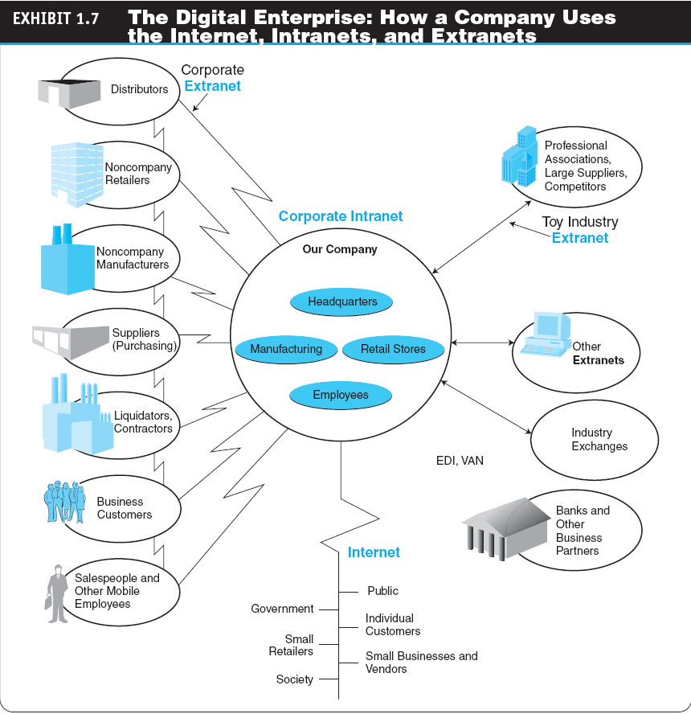

Slide 28
The Digital World: Economy, Enterprises, and Society
corporate portal
A major gateway through which employees, business partners, and the public can enter a corporate Web site

Slide 29
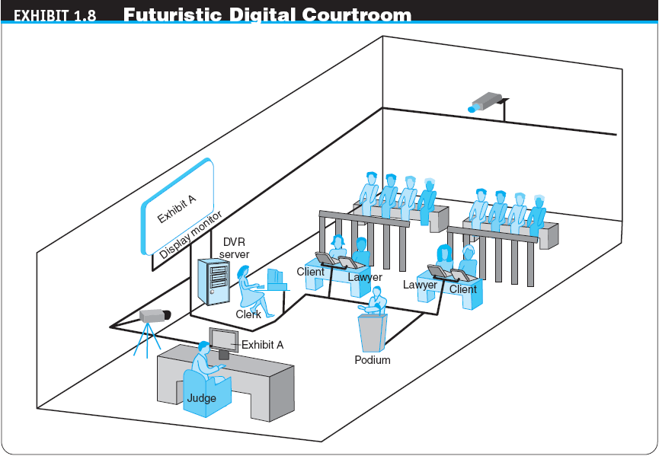
The Digital World: Economy, Enterprises, and Society

Slide 30
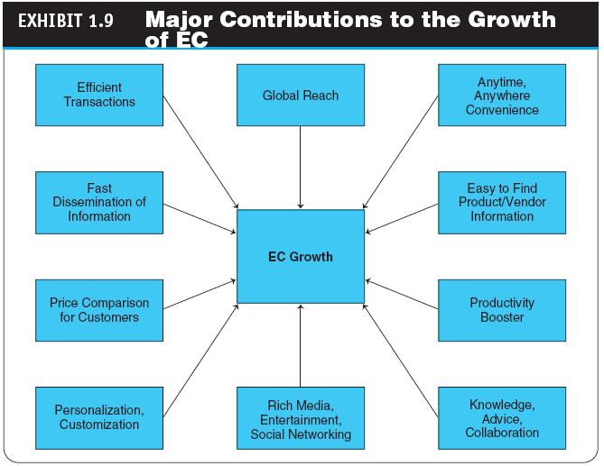

Slide 31
Electronic Commerce Drivers and the Changing Business Environment
The Changing Business Environment
Economic, legal, societal, and technological factors have created a highly competitive business environment in which customers are becoming more powerful
These environmental factors can change quickly, vigorously, and sometimes in an unpredictable manner
Companies need to react quickly to both the problems and the opportunities resulting from this new business environment

Slide 32
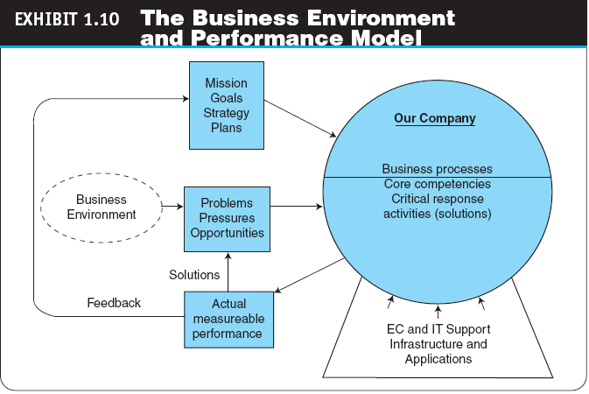
Electronic Commerce Drivers and the Changing Business Environment

Slide 33
Electronic Commerce Drivers and the Changing Business Environment
The Business Environment and Performance Impact Model
Business Pressures
Organizational Response Strategies

Slide 34
Electronic Commerce Business Models
business model
A method of doing business by which a company can generate revenue to sustain itself

Slide 35
Electronic Commerce Business Models
THE STRUCTURE AND PROPERTIES OF BUSINESS MODELS
Revenue Models
Sales
Transaction fees
Subscription fees
Advertising fees
Affiliate fees
Other revenue sources (play games, licensing fees)

Slide 36
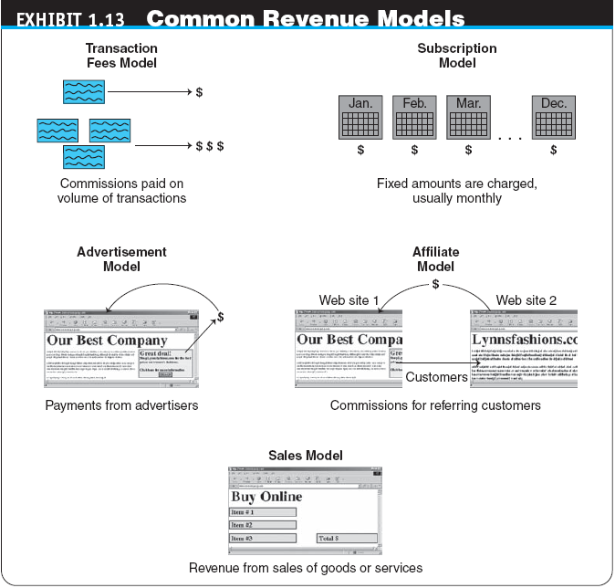

Slide 37
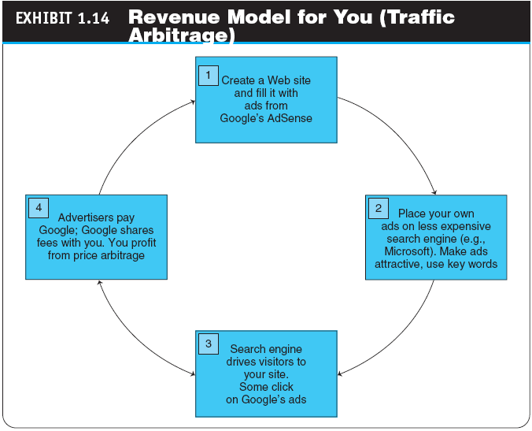

Slide 38
Electronic Commerce Business Models
value proposition
The benefits a company can derive from using EC
Functions of a Business Model

Slide 39
Electronic Commerce Business Models
TYPICAL EC BUSINESS MODELS
Online direct marketing
Electronic tendering systems
tendering (bidding) system
Model in which a buyer requests would-be sellers to submit bids; the lowest bidder wins
Electronic marketplaces and exchanges
Viral marketing
Social networking and Web 2.0 tools

Slide 40
The Benefits, Limitations, and Impacts of Electronic Commerce
THE BENEFITS AND IMPACTS OF EC
EC provides benefits to organizations, individual customers, and society
Ethical Issues
ethics
The branch of philosophy that deals with what is considered to be right and wrong
WHY STUDY E-COMMERCE?

Slide 41
Managerial Issues
Is it real?
Why is B2B e-commerce so essential?
What should be my business model?
How do we transform our organization into a digital one?
How should we evaluate the magnitude of business pressures and technological advancement?
How can we exploit social/business networking?
What should be my company’s strategy toward EC?
What are the top challenges of EC?

